Slide 1
R/Bioconductor for single cell RNAseq data analysis: Identifying and characterizing single cell subpopulations with PAGODA
Jean Fan
PhD Candidate in Bioinformatics and Integrative Genomics / Kharchenko Lab / Harvard Medical School

Slide 2
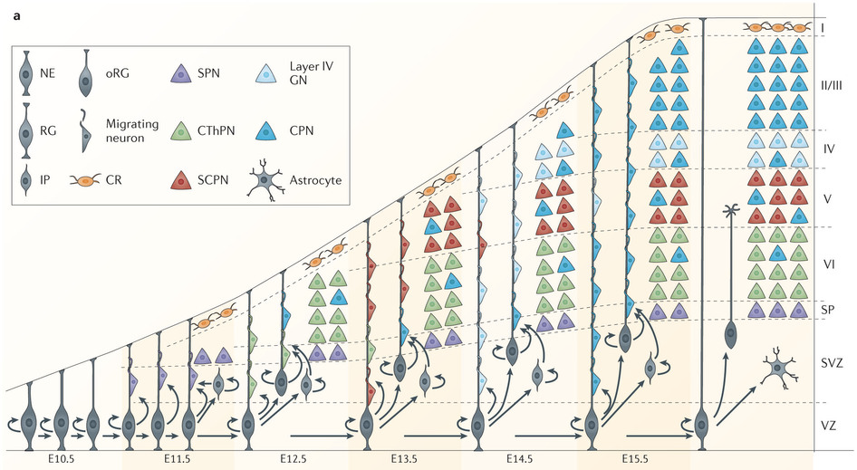
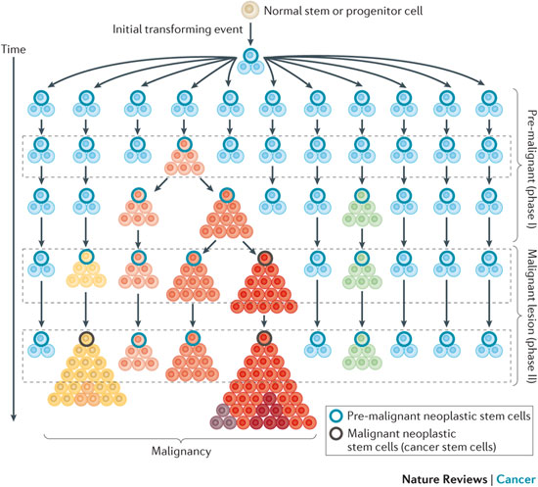
Motivation: Characterize heterogeneity and identify cell subpopulations
NPCs
Cancer
Greig LC, Woodworth MB, Galazo MJ, Padmanabhan H, Macklis JD. Molecular logic of neocortical projection neuron specification, development and diversity. Nat Rev Neurosci. 2013;14(11):755-69.
Valent P, Bonnet D, De maria R, et al. Cancer stem cell definitions and terminology: the devil is in the details. Nat Rev Cancer. 2012;12(11):767-75.

Slide 3
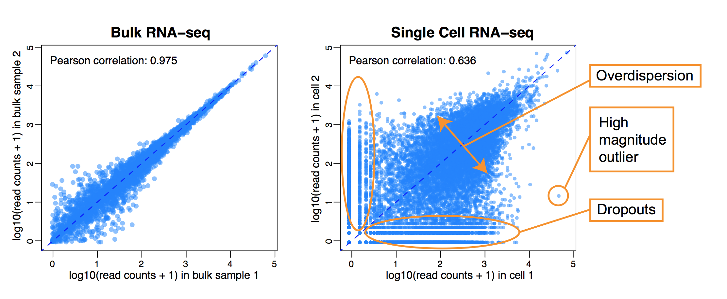
Challenges: scRNA-seq data is highly variable and noisy
Expect high correlation between replicates
Many differences between individual cells (even of the same type)
Biological vs. technical differences
Notes:
Thresholding or attempting to remove poor genes or data is challenging because you throw everything away!

Slide 4
Talk Outline
How can we identify transcriptional subpopulations in a way that is robust and takes into consideration technical artefacts from single cell RNA-seq?
In additional to expression heterogeneity, how can we make the most out of single-cell RNA-seq data?
How can we connect transcriptional heterogeneity to genetic heterogeneity at the single cell level?
Demo

Slide 5
Talk Outline
How can we identify transcriptional subpopulations in a way that is robust and takes into consideration technical artefacts from single cell RNA-seq?
In additional to expression heterogeneity, how can we make the most out of single-cell RNA-seq data?
How can we connect transcriptional heterogeneity to genetic heterogeneity at the single cell level?
Demo

Slide 6

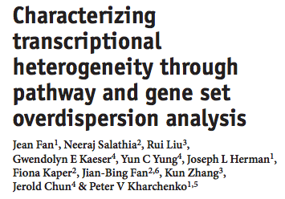
PAGODA (Pathway And Geneset OverDispersion Analysis) uses gene sets and pathways to characterize heterogeneity and identify subpopulations
Nature Methods 13, 241–244 (2016)
doi:10.1038/nmeth.3734
Notes:
Actually identify subpopulations

Slide 7
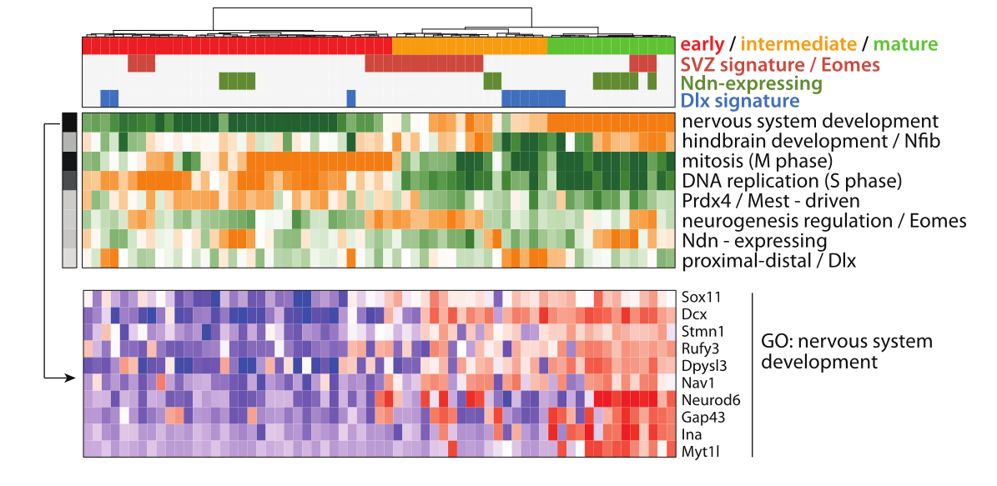
PAGODA intuition: Improve statistical sensitivity by taking advantage of pathways and gene sets
Rather than relying on a few genes, look for broader patterns of variability
Coordinated patterns of variability of genes linked to function/phenotype == stronger signal -> increases statistical power
Notes:
DCX = neuronal maturation marker
Previous FACs rely on just one marker
PAGODA builds on these error models
Rather than variability of genes,
coordinated variability of genes within a pathway or gene set
The general intuition…
you can image if I have
many cells one gene
red is high blue is low

Slide 8
PAGODA intuition: Improve statistical sensitivity by taking advantage of pathways and gene sets
Rather than relying on a few genes, look for broader patterns of variability
Coordinated patterns of variability of genes linked to function/phenotype == stronger signal -> increases statistical power
Notes:
PAGODA builds on these error models
Rather than variability of genes,
coordinated variability of genes within a pathway or gene set
The general intuition…
you can image if I have
many cells one gene
red is high blue is low

Slide 9
PAGODA intuition: Improve statistical sensitivity by taking advantage of pathways and gene sets
Rather than relying on a few genes, look for broader patterns of variability
Coordinated patterns of variability of genes linked to function/phenotype == stronger signal -> increases statistical power
Notes:
PAGODA builds on these error models
Rather than variability of genes,
coordinated variability of genes within a pathway or gene set
The general intuition…
you can image if I have
many cells one gene
red is high blue is low

Slide 10
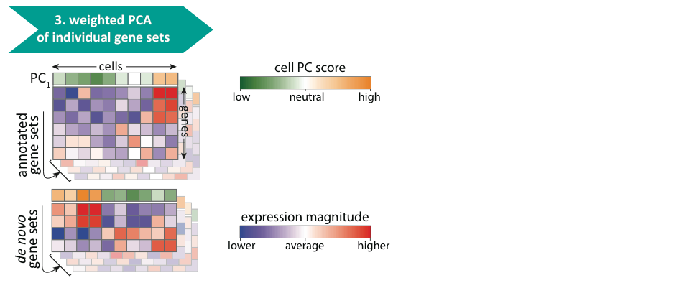
PAGODA overview: assess expression within annotated pathways and de novo gene sets
Notes:
After error modeling…
Explain green and orange
Red and green
split de novo and top section
Given annotations from MsigDB, GO, or other ontologies
we integrate the error models previously mentioned and use weighted PCA to capture the variability of a gene set in principle components
where weights are derived from our error modeling
because annotations are limited, we also derive ‘de novo’ gene sets based on correlated expression patterns we observe directly from the data
Capturing the patterns of variability

Slide 11
PAGODA overview: assess expression within annotated pathways and de novo gene sets
Notes:
because annotations are limited, we also derive ‘de novo’ gene sets based on correlated expression patterns we observe directly from the data

Slide 12
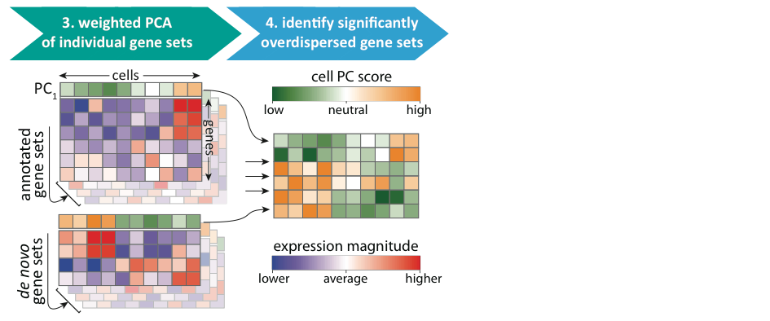
PAGODA overview: Identify pathways and gene sets exhibiting coordinated over dispersion
Notes:
We focus on the pathways and gene sets that exhibit significantly coordinated variability
Statistical significance of the λ1 eigenvalues obtained for each gene set was evaluated based on the Tracy-Widom F1 distribution F1(m,ne ), where m is the number of
genes in a given set s, and ne is the effective number of cells, determined to fit the distribution of the randomly sampled gene sets (containing the same number of genes as the actual gene sets).

Slide 13
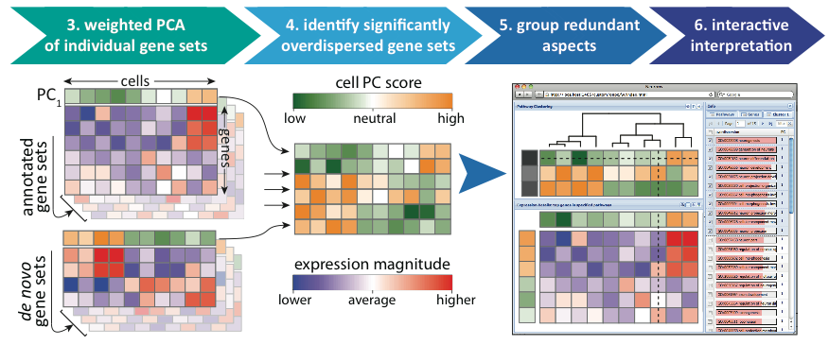
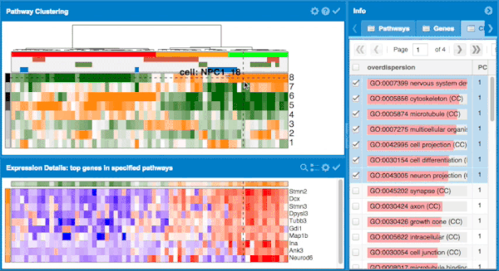
PAGODA overview: Remove redundancy pathways and gene sets, and visualize
Notes:
But many pathways and gene sets share genes or show similar patterns of variability across cells
we further collapse these redundancies into pathway clusters
Ultimately finally providing a cell clustering
along with an interactive browser to explore these results
Label middle heatmap

Slide 14

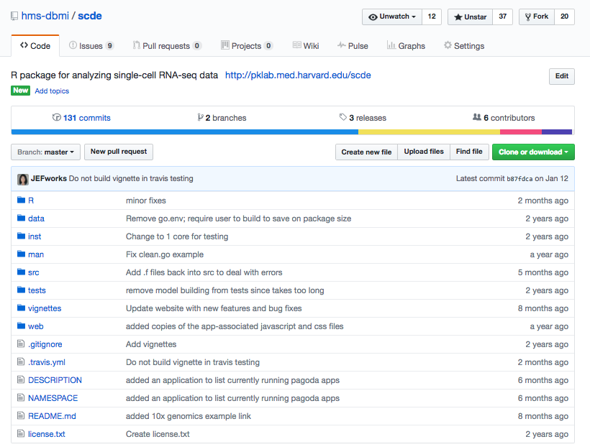
PAGODA is available as part of the SCDE package on Bioconductor and Github
pklab.med.harvard.edu/scde
Notes:
Actually identify subpopulations

Slide 15
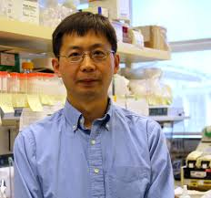

PAGODA applied to mouse neural progenitors identifies and characterizes subpopulations
pathway clusters
Kun Zhang
cells
Jerold Chun
Notes:
Demonstrate the utility of PAGODA
NPCs from embryonic 13.5 mouse
Row is pathway cluster
Column is a cell
PAGODA pulls out aspects of transcriptional heterogeneity
Focus on the most prominent aspect

Slide 16
PAGODA applied to mouse neural progenitors identifies and characterizes subpopulations
Notes:
Demonstrate the utility of PAGODA
NPCs from embryonic 13.5 mouse
Row is pathway cluster
Column is a cell
PAGODA pulls out aspects of transcriptional heterogeneity
Focus on the most prominent aspect

Slide 17
PAGODA applied to mouse neural progenitors identifies and characterizes subpopulations
Notes:
Explore genes and pathways driving this pathway cluster

Slide 18
PAGODA applied to mouse neural progenitors identifies and characterizes subpopulations
Notes:
interpret this aspects of transcriptional heterogeneity as relating to

Slide 19
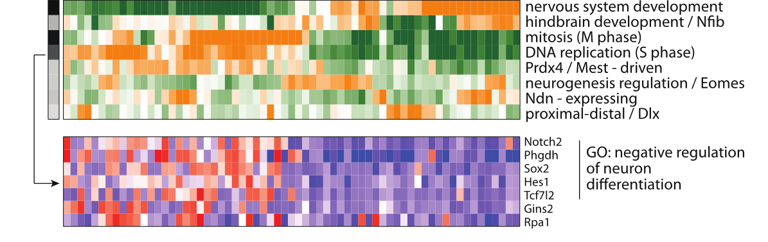
PAGODA applied to mouse neural progenitors identifies and characterizes subpopulations
Notes:
Alternatively, a can focus on a different aspect of transcriptional heterogeneity

Slide 20
PAGODA applied to mouse neural progenitors identifies and characterizes subpopulations
Notes:
Similarly for rest of the pathway clusters

Slide 21
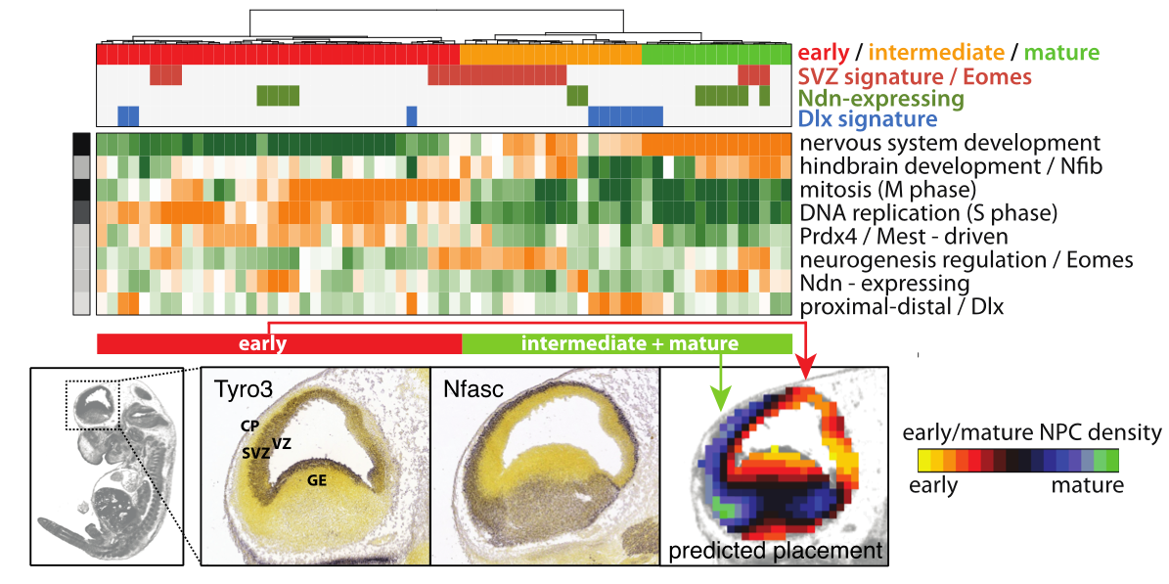
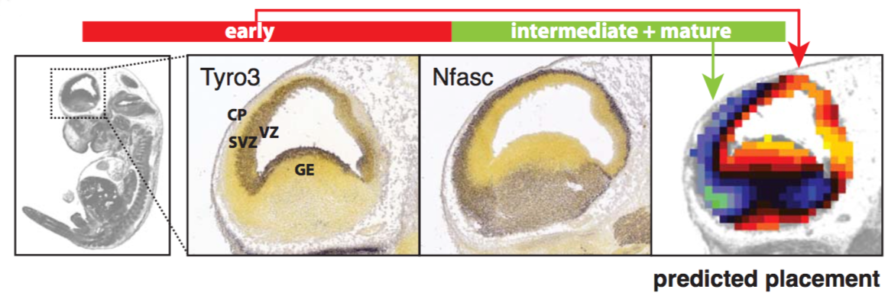
PAGODA applied to mouse neural progenitors identifies and characterizes subpopulations
Notes:
Based on the genes and pathways driving this primary aspects of transcriptional heterogeneity, we can interpret the corresponding cells as early and intermediate or mature NPCs
Indeed, when we look at how the genes associated with these subpopulations localize in the brain, we see
signatures associated with early NPCs localize to the sub ventricular zone
while sigs assoc…further outwards
which is consistent with what’s known about NPC migration through the ventricular zone during development
Credit images to allen brain atlas
Move mouse block down, label out

Slide 22
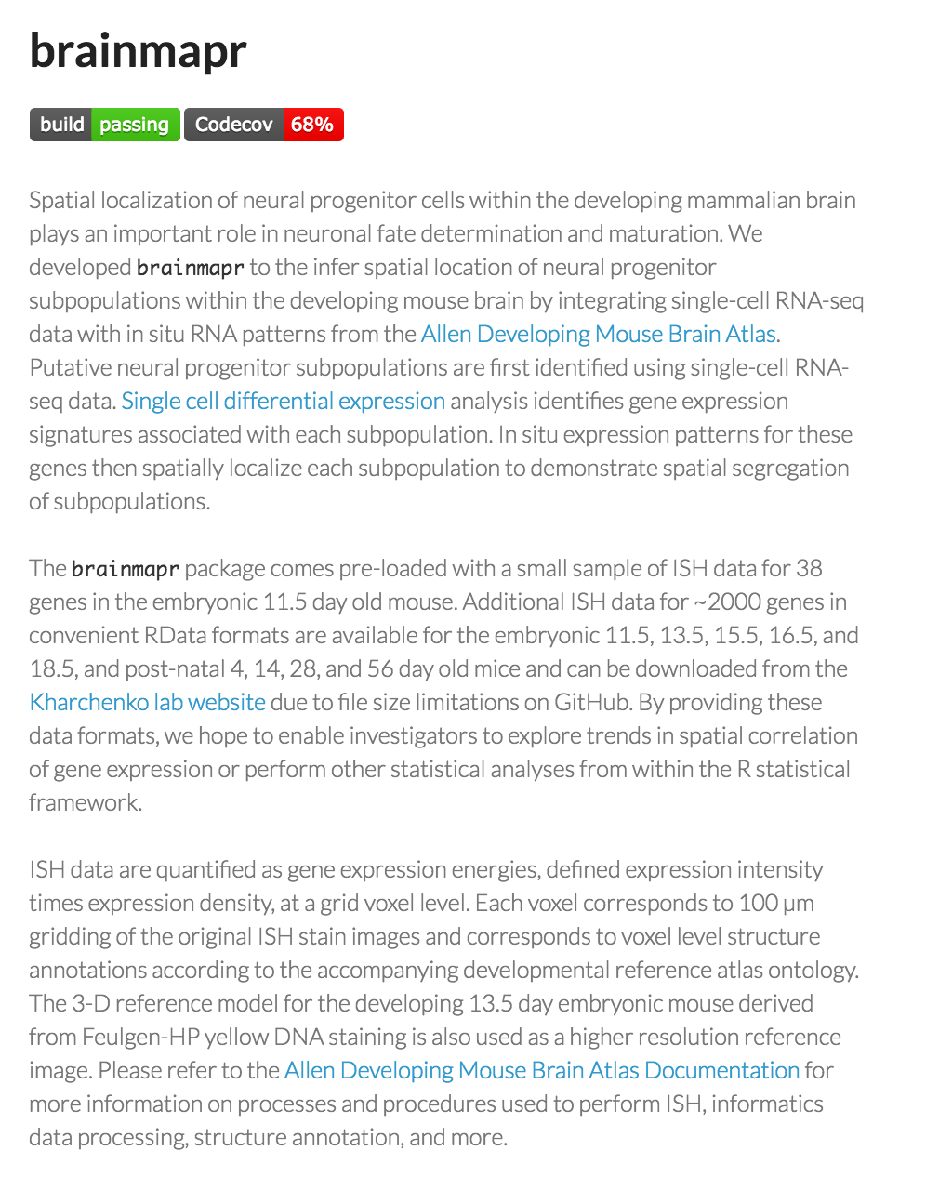
PAGODA integrated with FISH data spatially placed subpopulations
github.com/hms-dbmi/brainmapr

Slide 23
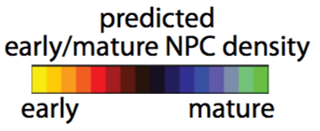
PAGODA integrated with FISH data spatially placed subpopulations
Allen Brain Atlas; https://github.com/hms-dbmi/brainmapr
Notes:
Indeed, when we look at how the genes associated with these subpopulations localize in the brain, we see
signatures associated with early NPCs localize to the sub ventricular zone
while sigs assoc…further outwards
which is consistent with what’s known about NPC migration through the ventricular zone during development
Credit images to allen brain atlas
Move mouse block down, label out

Slide 24

PAGODA identifies multiple, potentially overlapping aspects of transcriptional heterogeneity
Notes:
There are potentially many ways to group cells
such as mature vs. early NPCs
Often we find the primary component of variation driving cell differences is cell cycle
Some times, we’re not interested in cell cycle
Important to be able to look at additional aspects of transcriptional heterogeneity that may not agree with the primary split
It is known that these are tangentially migrating neurons
some are early, some are mature
Add prediction figure

Slide 25
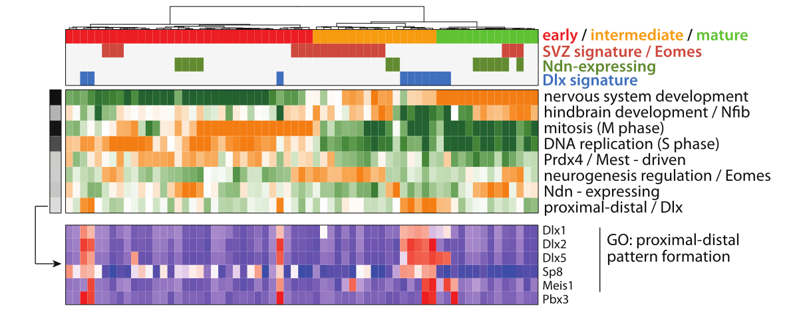
PAGODA identifies multiple, potentially overlapping aspects of transcriptional heterogeneity
Notes:
There are potentially many ways to group cells
such as mature vs. early NPCs
Often we find the primary component of variation driving cell differences is cell cycle
Some times, we’re not interested in cell cycle
Important to be able to look at additional aspects of transcriptional heterogeneity that may not agree with the primary split
It is known that these are tangentially migrating neurons
some are early, some are mature
Add prediction figure

Slide 26
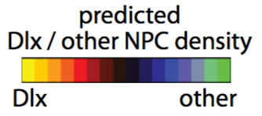
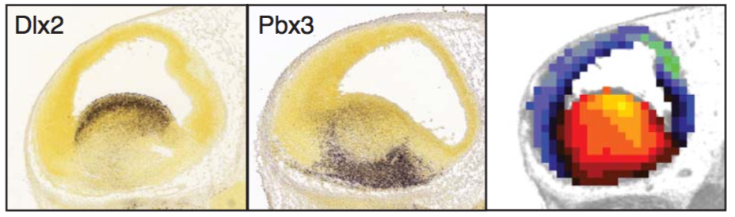
PAGODA identifies multiple, potentially overlapping aspects of transcriptional heterogeneity
Notes:
There are potentially many ways to group cells
such as mature vs. early NPCs
Often we find the primary component of variation driving cell differences is cell cycle
Some times, we’re not interested in cell cycle
Important to be able to look at additional aspects of transcriptional heterogeneity that may not agree with the primary split
It is known that these are tangentially migrating neurons
some are early, some are mature
Add prediction figure

Slide 27
Talk Outline
How can we identify transcriptional subpopulations in a way that is robust and takes into consideration technical artefacts from single cell RNA-seq?
In additional to expression heterogeneity, how can we make the most out of single-cell RNA-seq data?
How can we connect transcriptional heterogeneity to genetic heterogeneity at the single cell level?
Demo

Slide 28
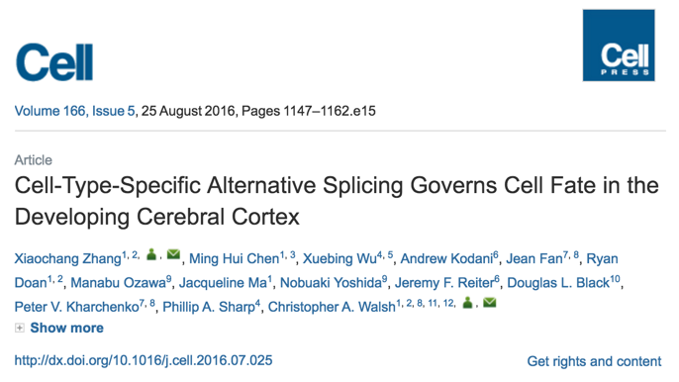
PAGODA applied to human cortical cells identifies and characterizes subpopulations
Xiaochang Zhang
Chris Walsh
Notes:
We applied PAGODA to identify subpopulations
CLS

Slide 29
PAGODA applied to human cortical cells identifies and characterizes subpopulations
pathway clusters
cells
Notes:
We applied PAGODA to identify subpopulations

Slide 30
Marker genes confirm subpopulation identified by PAGODA
Notes:
Look at known marker genes for interpretation.
Indeed, we've identified radial glials or mature neurons...
Instead of looking at gene expression, let's look at alternative splicing

Slide 31
Marker genes confirm subpopulation identified by PAGODA
Notes:
Now that we have pure single cell subpopulations, let’s create pure in silico bulks

Slide 32
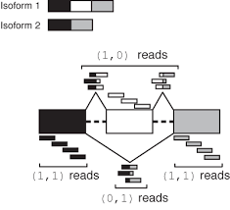

PAGODA integrated with MISO identifies alternative splicing in pure pooled single cells
Notes:
Chris Burge’s lab at MIT

Slide 33
PAGODA integrated with MISO identifies alternative splicing in pure pooled single cells
Needs bulk

Slide 34
PAGODA integrated with MISO identifies alternative splicing in pure pooled single cells
Needs bulk -> pool single cells
Notes:
Create in silico mini-bulks

Slide 35
Marker genes confirm subpopulation identified by PAGODA
Notes:
Now that we have pure single cell subpopulations, let’s create pure in silico bulks

Slide 36
Pure pooled RGs vs neurons lend credence to potential purity concerns with bulk CP vs. VZ
Notes:
Sashimi plots

Slide 37
Pure pooled RGs vs neurons lend credence to potential purity concerns with bulk CP vs. VZ
Notes:
Bulk microdissection
See same trends
Reviewers were initially concerned about purity of bulk

Slide 38
Talk Outline
How can we identify transcriptional subpopulations in a way that is robust and takes into consideration technical artefacts from single cell RNA-seq?
In additional to expression heterogeneity, how can we make the most out of single-cell RNA-seq data?
How can we connect transcriptional heterogeneity to genetic heterogeneity at the single cell level?
Demo

Slide 39
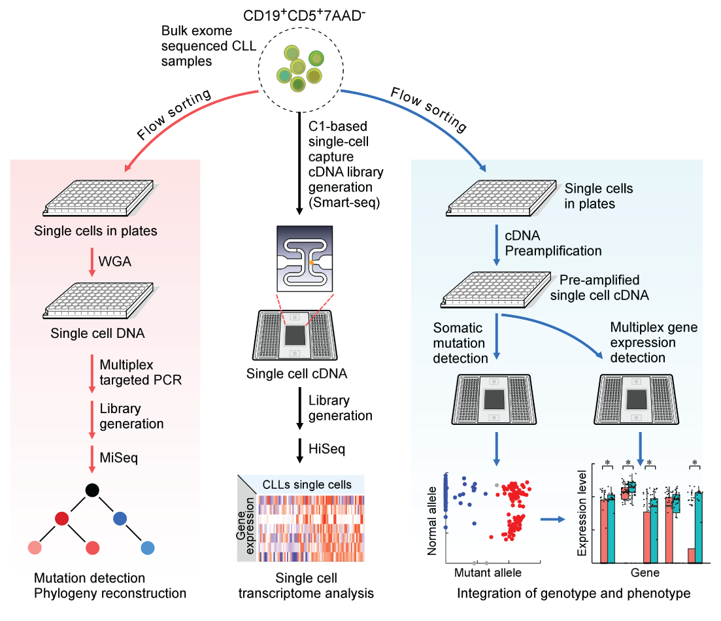

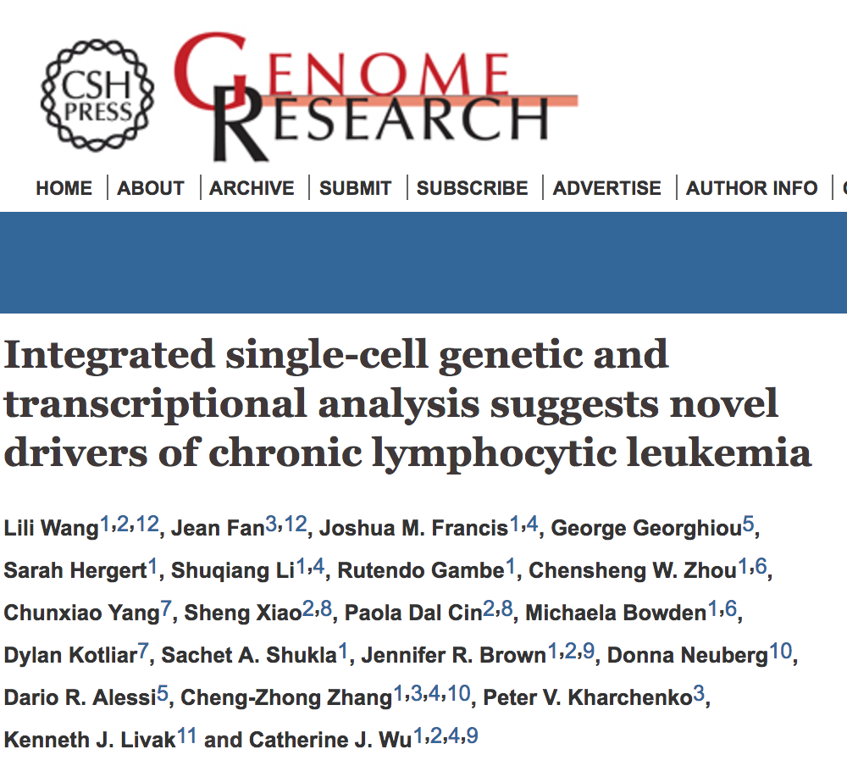
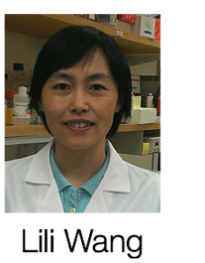
Integrated analysis targeted single-cell genetic and transcriptional heterogeneity to study novel drivers in CLL

Slide 40
Integrated analysis targeted single-cell genetic and transcriptional heterogeneity to study novel drivers in CLL

Slide 41
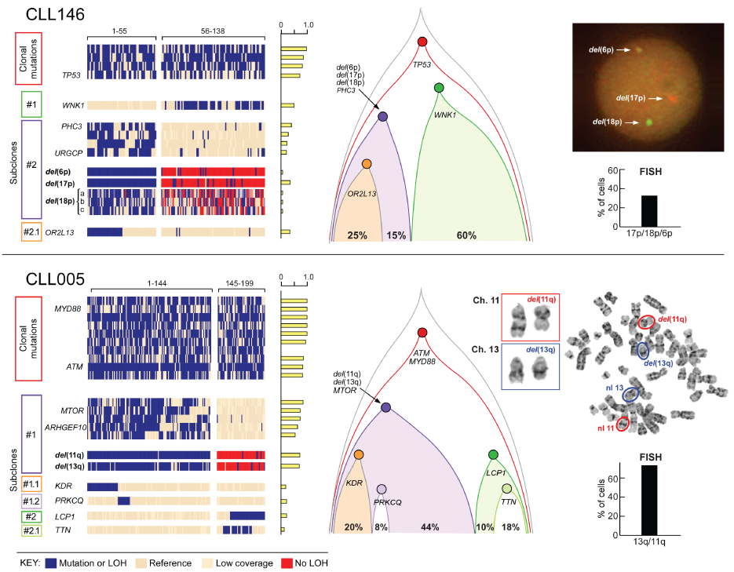
Single cell targeted DNA sequencing reveals branching evolution not evident from bulk

Slide 42
Integrated analysis targeted single-cell genetic and transcriptional heterogeneity to study novel drivers in CLL

Slide 43
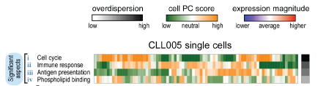
Single cell RNA-seq + Pathway and Geneset OverDispersion Analysis (PAGODA) identifies transcriptional heterogeneity

Slide 44
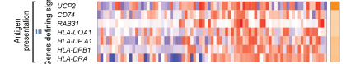
Single cell RNA-seq + Pathway and Geneset OverDispersion Analysis (PAGODA) identifies transcriptional heterogeneity

Slide 45
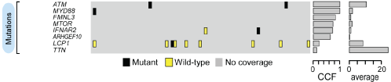
Single cell RNA-seq + Pathway and Geneset OverDispersion Analysis (PAGODA) identifies transcriptional heterogeneity

Slide 46
Single cell RNA-seq + Pathway and Geneset OverDispersion Analysis (PAGODA) identifies transcriptional heterogeneity
Mutation calling too sparse in single cell RNA-seq
to be able to connect transcriptional heterogeneity with genetic branches

Slide 47
High mono-allelic detection and sparse coverage limits ability to confidently infer point mutations in scRNA-seq data

Slide 48
Integrated analysis of targeted single-cell genetic and transcriptional heterogeneity to study novel drivers in CLL

Slide 49
Integrated analysis of targeted single-cell genetic and transcriptional heterogeneity to study novel drivers in CLL

Slide 50
RNA-based mutation and point mutation calling recapitulates known genetic architecture and resolves known genetic branches

Slide 51
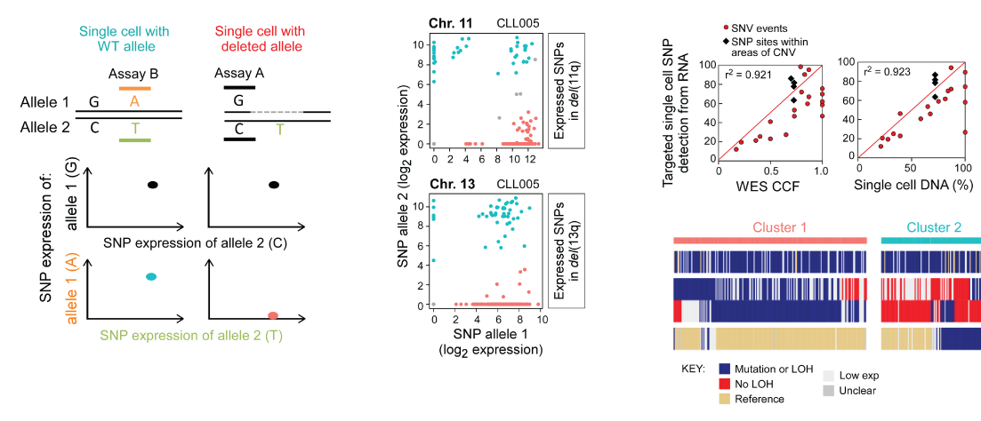
RNA-based mutation and point mutation calling recapitulates known genetic architecture and resolves known genetic branches

Slide 52
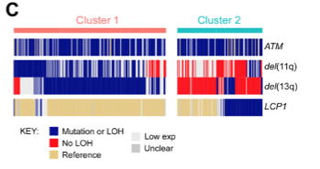
RNA-based mutation and point mutation calling recapitulates known genetic architecture and resolves known genetic branches

Slide 53
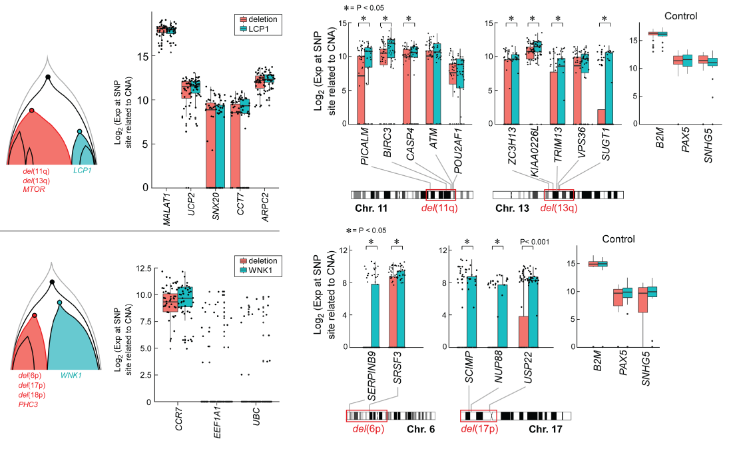
Integrated analysis reveals phenotypic convergence between distinct subclones

Slide 54
Integrated analysis reveals phenotypic convergence between distinct subclones

Slide 55
Talk Outline
How can we identify transcriptional subpopulations in a way that is robust and takes into consideration technical artefacts from single cell RNA-seq?
In additional to expression heterogeneity, how can we make the most out of single-cell RNA-seq data?
How can we connect transcriptional heterogeneity to genetic heterogeneity at the single cell level?
Demo

Slide 56
https://github.com/JEFworks/R-Bioconductor-for-single-cell-RNAseq-data-analysis
bit.ly/ScTut

Slide 57
Increasing throughput of single cell sequencing requires lighter computational solutions
68k PBMC dataset from 10X
Full error models no longer feasible
Alternate multi-core approximations and data dimensionality reduction become necessary
Even data visualization becomes challenging!

Slide 58
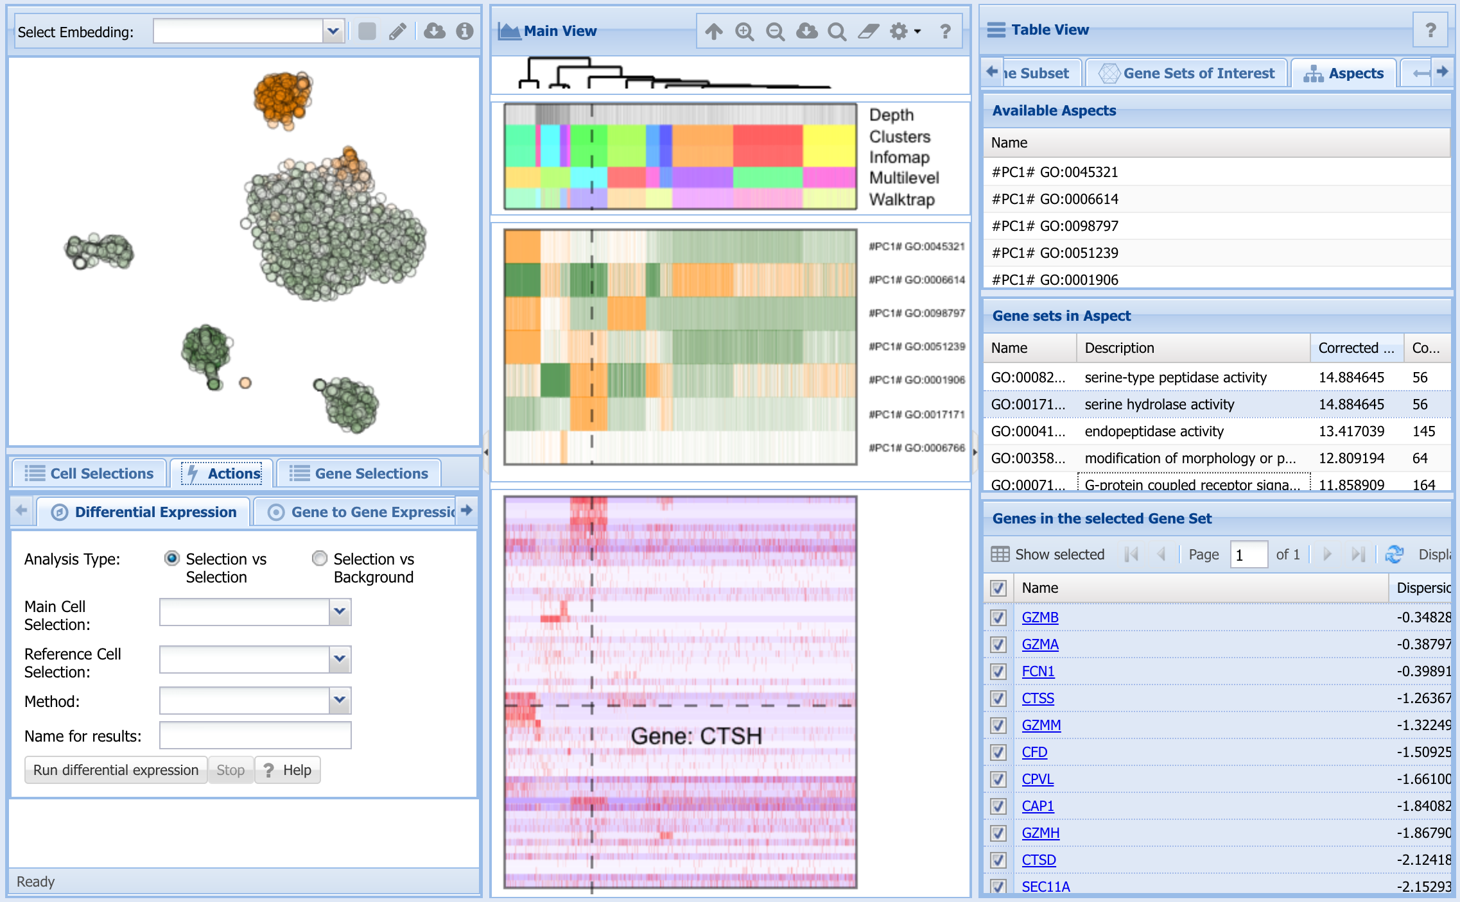
PAGODA2 demo

